Slide 1
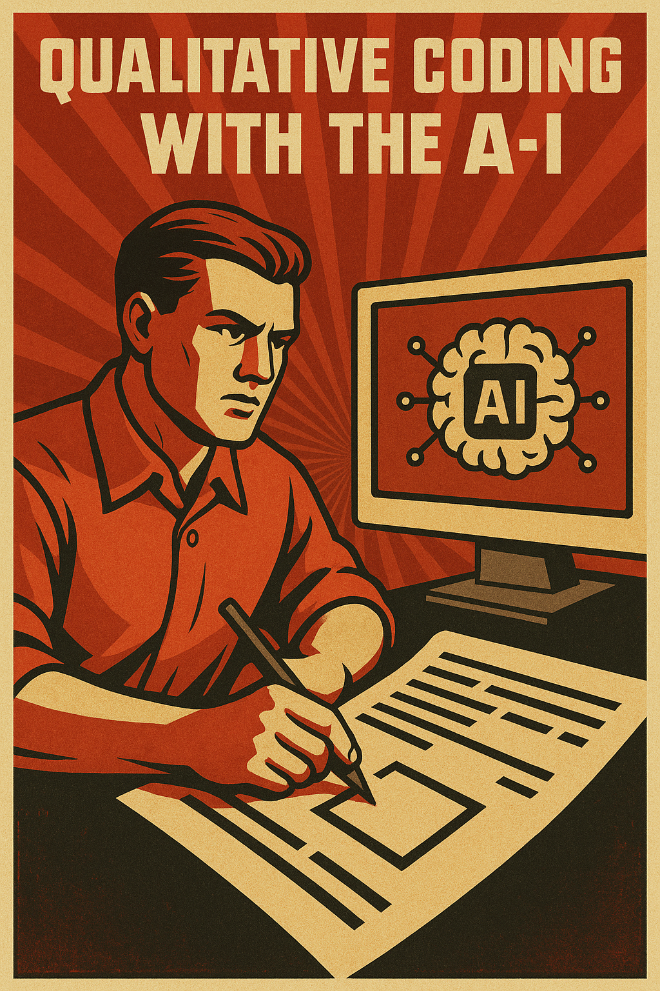

Slide 2
Ai studio
Google AI Studio
Model choice
Flash
Pro

Slide 3
API keys, SDKs and a Python API wrapper
[prompt: explain what an API key is and why you might use them]
[prompt: what is an SDK?]
[prompt: what is a python API wrapper?]

Slide 4
Load data
Load our previous data
[prompt: How do I load a csv or a parquet file into python as a pandas dataframe]

Slide 5
Join data
[prompt: I have two pandas dataframes I want to join. They have a common column “respondent_id” that I would like to join on]

Slide 6
Process data
We may need to process the text data
Strip whitespace (leading and trailing spaces)
Strip numbers
Strip punctuation
All text to lower case
Remove stopwords
[prompt: I have some responses to a survey that are free text. I have the text in a column in a dataframe and each response is in a row of that column. Some of the responses are all in capital letters, how do I make the text all lower case, so the responses are all the same?]
However, since we are using an LLM we probably don’t need to worry too much. These steps are more useful for traditional NLP

Slide 7
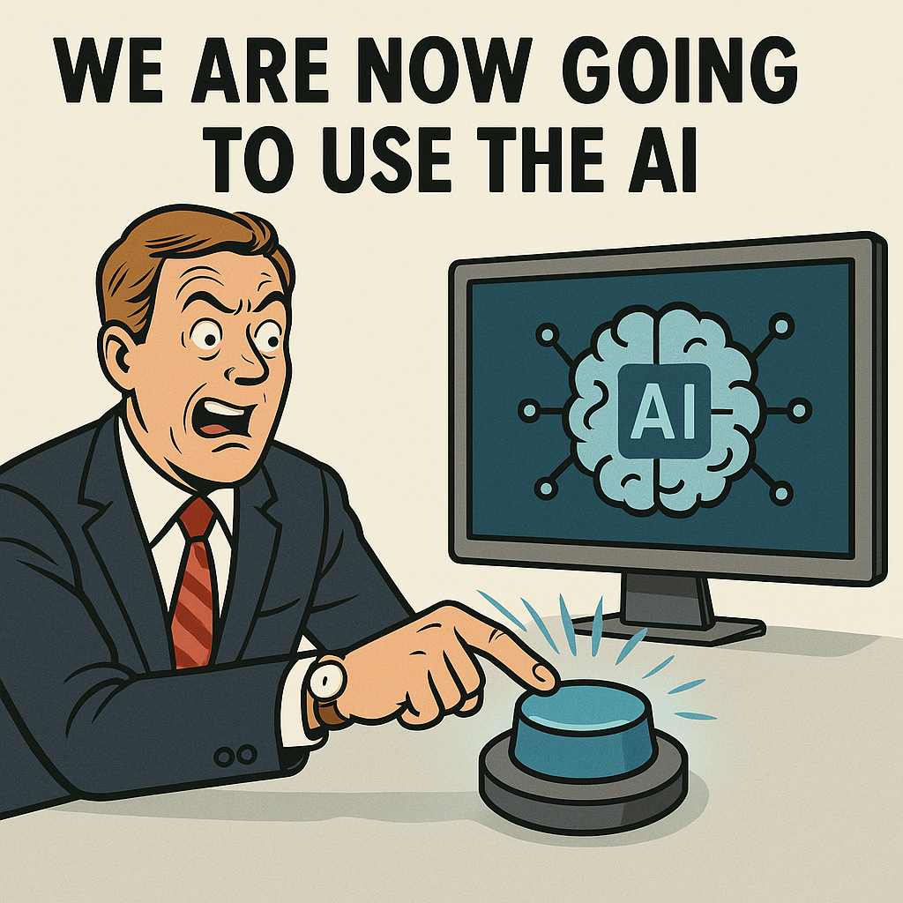
We are now going to use the AI

Slide 8
Context
[prompt: what is “context” in AI chats and why is it important?]
[bonus prompt: what is Model Context Protocol and why you might want to think about it in the future for AI]

Slide 9
Google AI studio – prompt prototyping
Cut/paste a few cells, write a terse prompt
Review the answers given by the AI chat
Refine the prompt
Repeat….

Slide 10
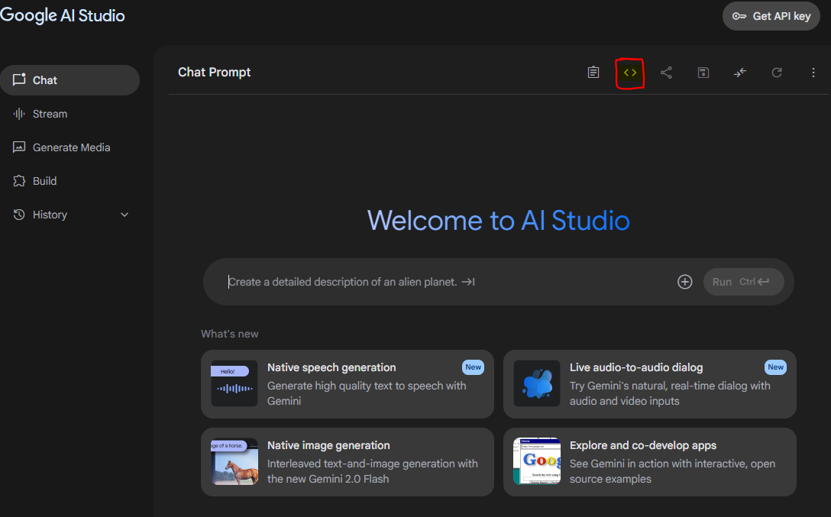
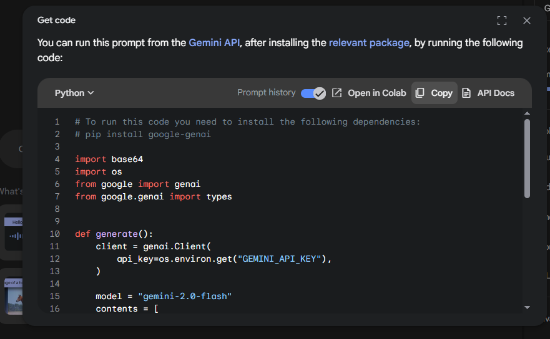
Making it work in code
Using the Google AI studio code button < >

Slide 11
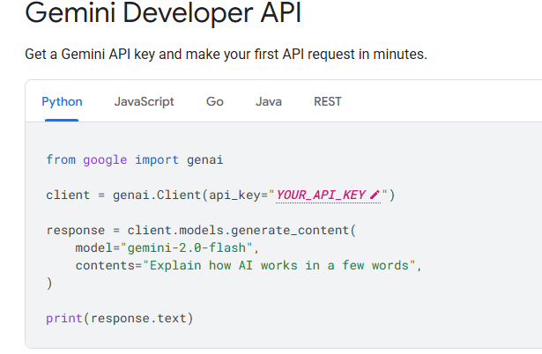
Read the Docs
Or we can read the documentation: https://ai.google.dev/gemini-api/docs

Slide 12
Getting the job done
Before we can really “prompt” we need to know what the system needs to do
Identify the source data
Set up the instructions
Inject the source data into the instructions
Format the output
Make sure that we can tie the output to the input
Get the output

Slide 13
Write the prompt
[prompt: I want to make a piece of python code that allows me to process free text survey responses using AI. The responses are in a column in a pandas dataframe. I need to be able to get all the responses into the context of the prompt as well as include any instructions on how to process the responses. I want to make sure that I can link the AI response back to each individual survey response. How can I get this to work in python using Google AI.]

Slide 14
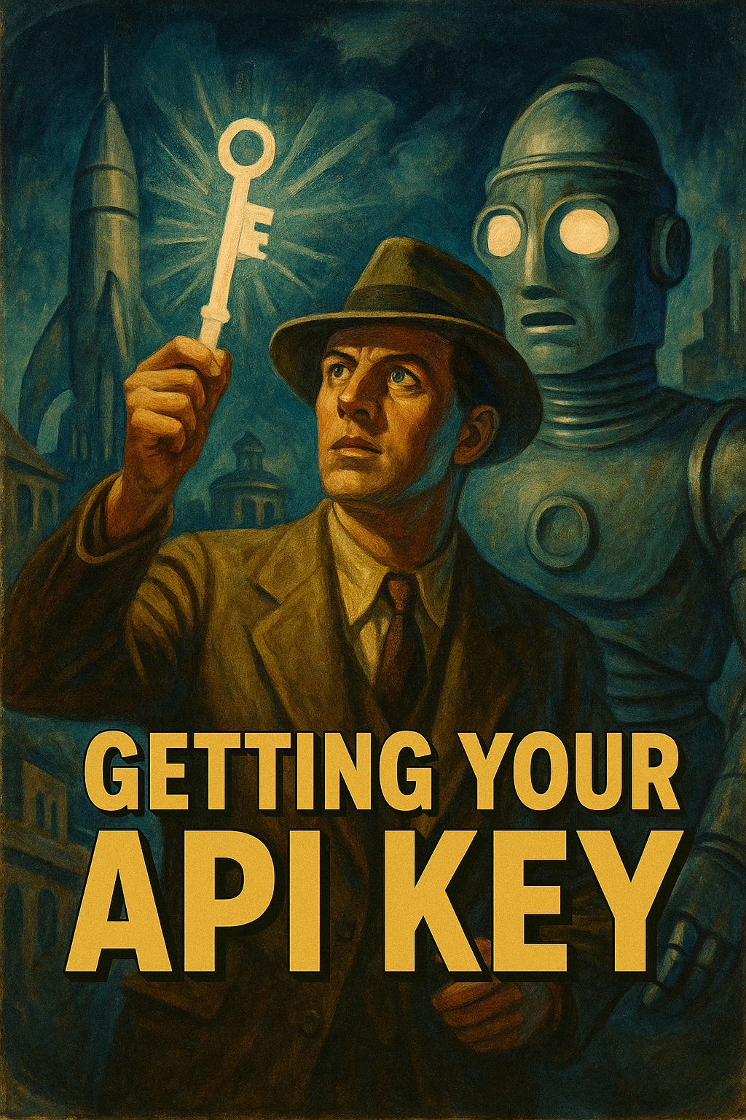
Get your API key

Slide 15
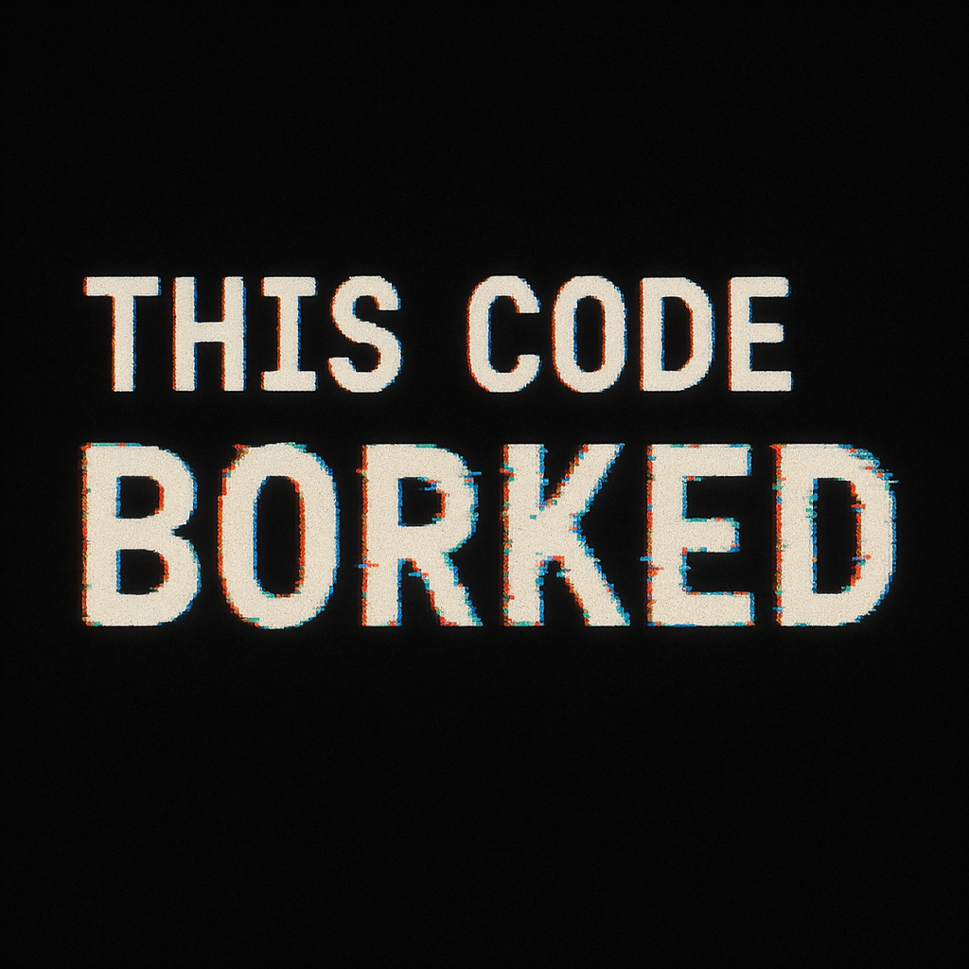
Review
Paste code into your IDE
Make sure the .venv has all the required packages
Run the code
What does it do?
Borked? Identify the errors adjust the prompt…
Paste the error message to the AI

Slide 16
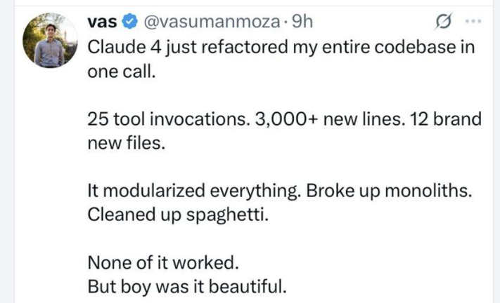
Trust?
[prompt]:why use code and not just rely on the AI to do the job for you?]

Slide 17
Get the results
How good are the results?
Should they be perfect?
[prompt: I have a human coder who gets the result correct 95% of the time. I also have an AI coder who gets the result correct 85% of the time. The only difference between the two coders is that the human can code 100 topics and the AI can code 100,000 topics in the same time taken. Given the accuracy figures explain how coding 100,000 topics at 85% is better that coding 100 at 95%]

Slide 18
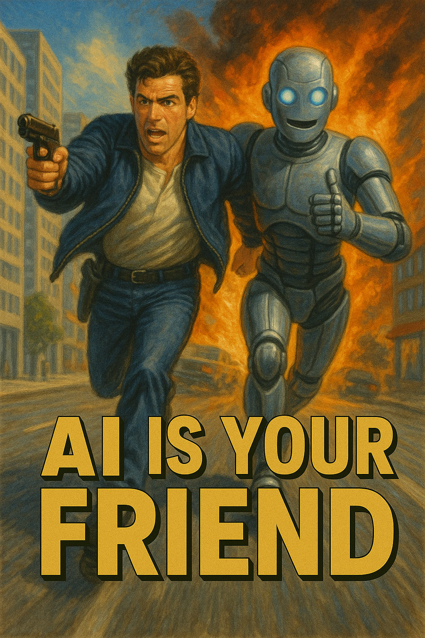
Talking about AI
Foundation Models
Open-source models
Hosted Models
Local Models
Agents and Agentic Models

